Slide 1
FRAMEWORK
-Presention by JYOTHISHMA

Slide 2
🔹What is Framework?
A framework is a collection of prewritten code, libraries, and best practices that provides a structure for developing software applications.
A framework helps developers save time by giving them a solid base to build on — instead of starting from zero.

Slide 3
🔹 Key Features
Reusable Code – Common functionalities (like authentication, database access, routing) are already built in.
Structure & Organization – Helps organize your project in a standard way (e.g., MVC: Model–View–Controller).
Faster Development – You focus on writing logic instead of re-creating basics.
Security & Stability – Built-in protections and tested components reduce errors.
Community Support – Large communities maintain and update frameworks.

Slide 4
💡 What is a PHP framework?
A PHP framework is a set of ready-made tools and code that helps you build PHP websites and web apps faster and easier.
It gives you:
A structure for your code
Built-in features (like login, database handling, routing)
Security and organization
So, instead of writing everything from scratch, you can use what’s already built.

Slide 5
🔹 Why use a PHP framework?
Faster development
Easier to maintain code
More secure
Follows good programming practices (like MVC – Model, View, Controller)

Slide 6
🔹 Popular PHP Frameworks
Framework | Description | Best for
Laravel | Modern, elegant, with built-in authentication, routing, and ORM (Eloquent). | Beginners to advanced developers
Symfony | Powerful, modular, and used for big, complex enterprise projects. | Large, scalable apps
CodeIgniter | Lightweight and super easy to learn. | Small to medium projects
CakePHP | Simple and quick for CRUD operations (Create, Read, Update, Delete). | Rapid web app development
Zend / Laminas | Flexible, professional-grade framework. | Enterprise-level applications

Slide 7
What is Laravel?
Laravel is a free, open-source PHP framework used to build web applications easily.
It provides ready-made tools and structure so developers don’t have to start from scratch every time
Basic Features of Laravel Routing, Migration, Artisan CLI , API Support
Without Laravel: You write long PHP code for database and pages.
With Laravel: You run short, clean code with built-in features.
Laravel saves time and makes development easier!
Laravel = A powerful PHP framework that helps you build modern, secure, and fast web applications with less effort.

Slide 8
Objective
Goal:
To develop a simple Laravel web API that performs CRUD (Create, Read, Update, Delete) operations on an existing 'notes' table.
Key Points:
- Connected Laravel to an existing MySQL database
- Created API routes for CRUD operations
- Tested all operations using Postman

Slide 9
Prerequisites
Installed Tools:
- XAMPP (Apache + MySQL)
- PHP ≥ 8.1
- Composer (Dependency Manager)
- Visual Studio Code
- Postman (for API Testing)

Slide 10
Install Composer
Download Composer
Go to 👉 https://getcomposer.org Click “Download” → “Composer-Setup.exe” for Windows.
Install
During installation:
It should automatically detect your PHP path:C:\xampp\php\php.exe
Click Next → Install → Finish

Slide 11
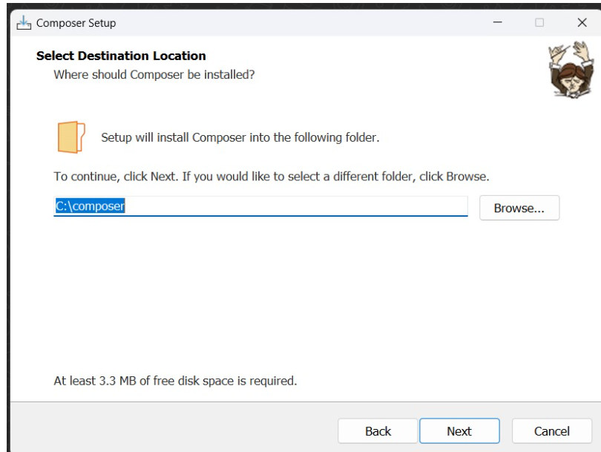
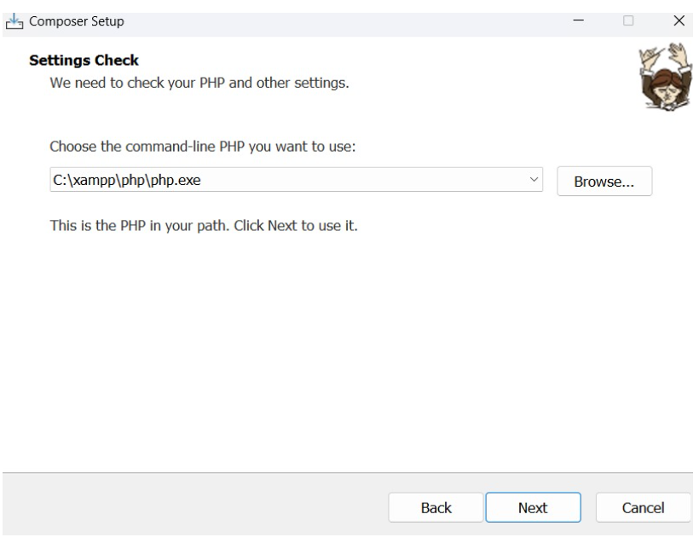
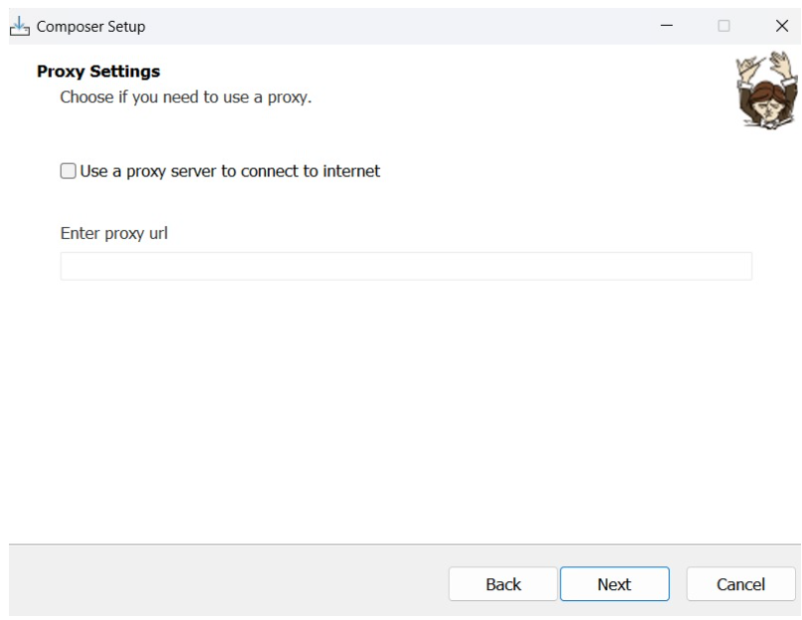
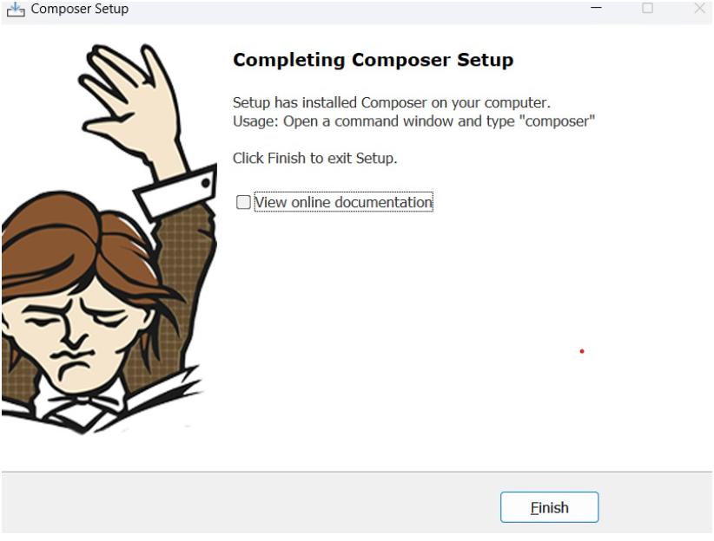
Composer Installation

Slide 12
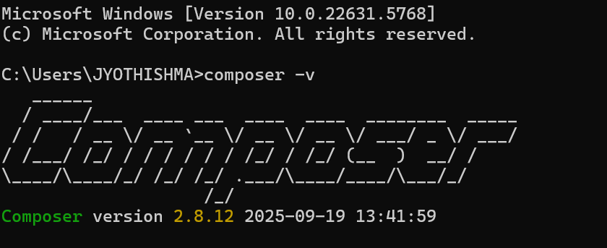
Verify installation
Open Command Prompt and type:
composer -V
You should see:
Composer version 2.x.x

Slide 13
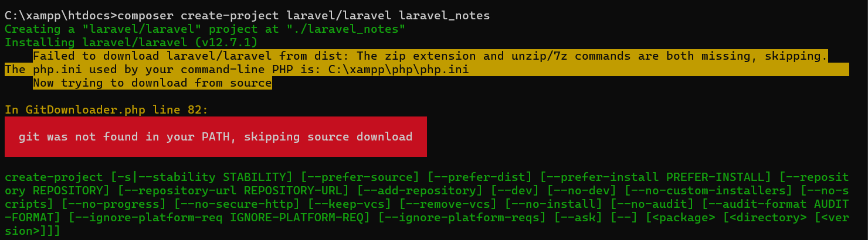
Create a Laravel Project in VS Code
Create via Command Prompt
Open Command Prompt.
Go to your XAMPP htdocs folder: cd C:\xampp\htdocs
Create a Laravel project:
composer create-project laravel/laravel laravel_notes

Slide 14
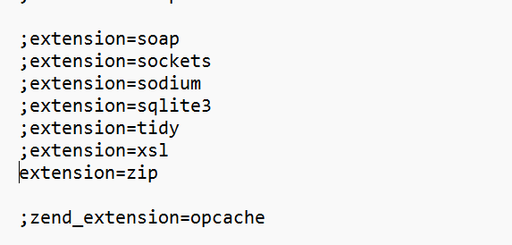
🧰 Fix:
Laravel needs ZIP support to unpack the framework files.
Open this file in VS Code or Notepad:
C:\xampp\php\php.ini
Search for this line (Ctrl + F → “zip”):
;extension=zip
Remove the semicolon (;) to enable it:
extension=zip
Save the file and restart Apache from XAMPP Control Panel.

Slide 15
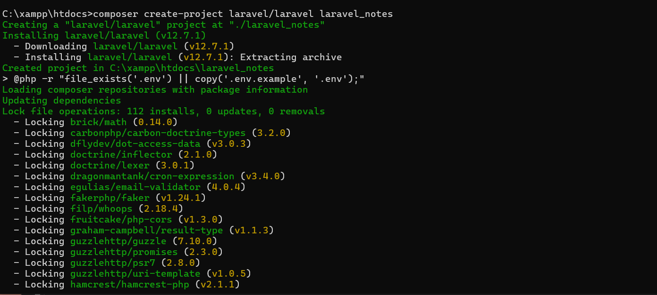
Creating a Laravel project
C:\xampp\htdocs>composer create-project laravel/laravel laravel_notes

Slide 16
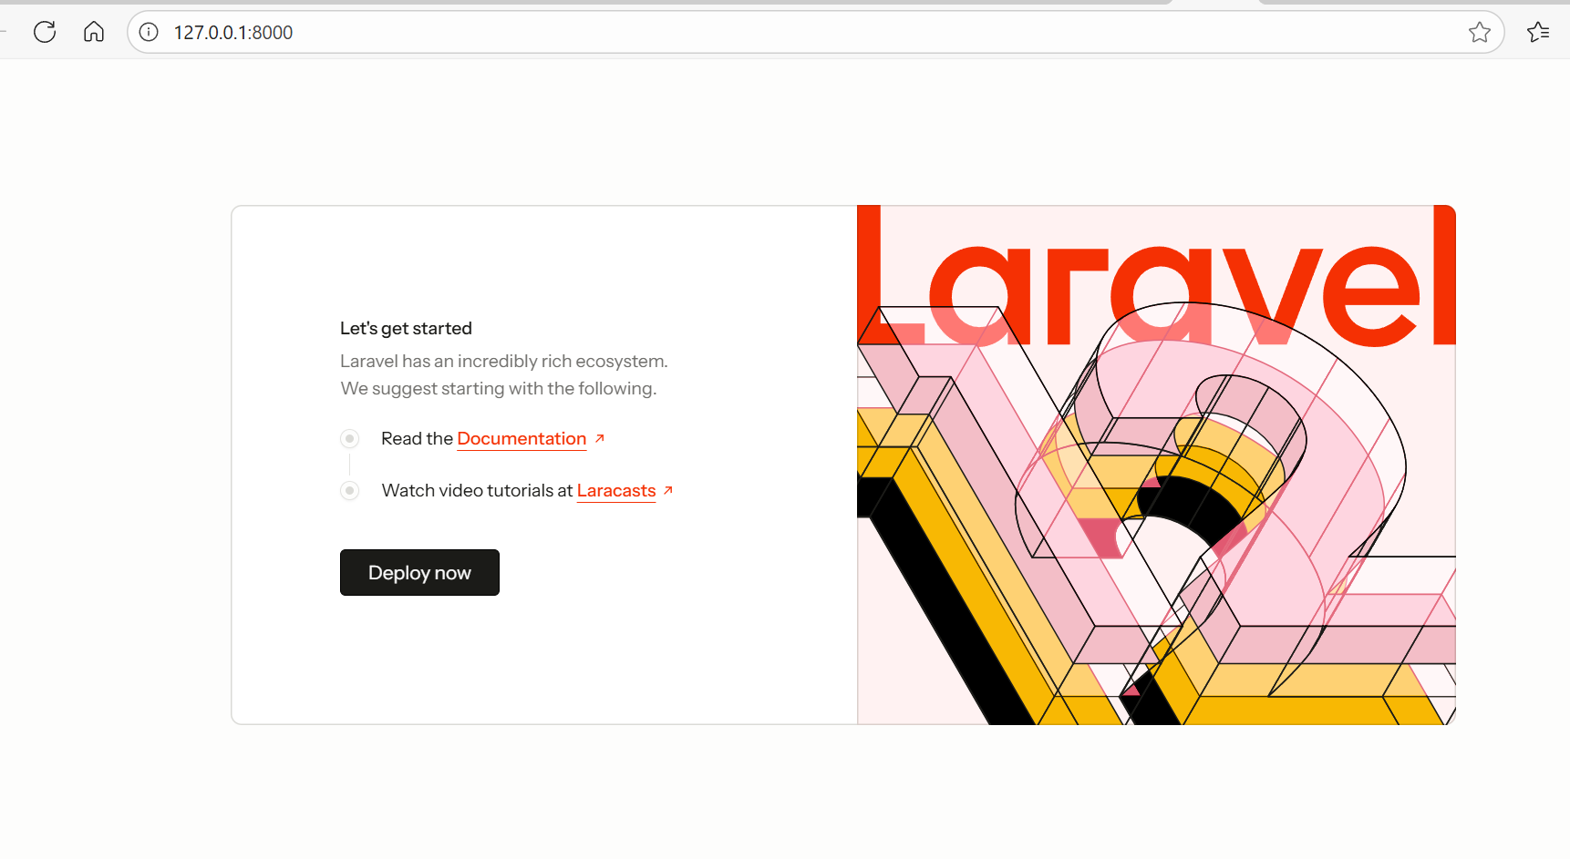
Open the Laravel Welcome Page
👉 http://127.0.0.1:8000

Slide 17
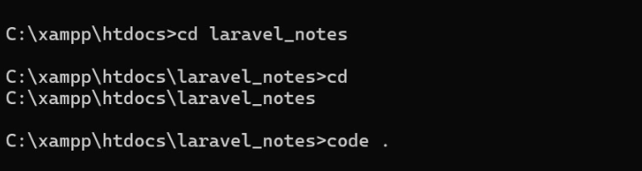
Open Your Laravel Project in VS Code
cd C:\xampp\htdocs
composer create-project laravel/laravel laravel_notes
cd laravel_notes
code .

Slide 18
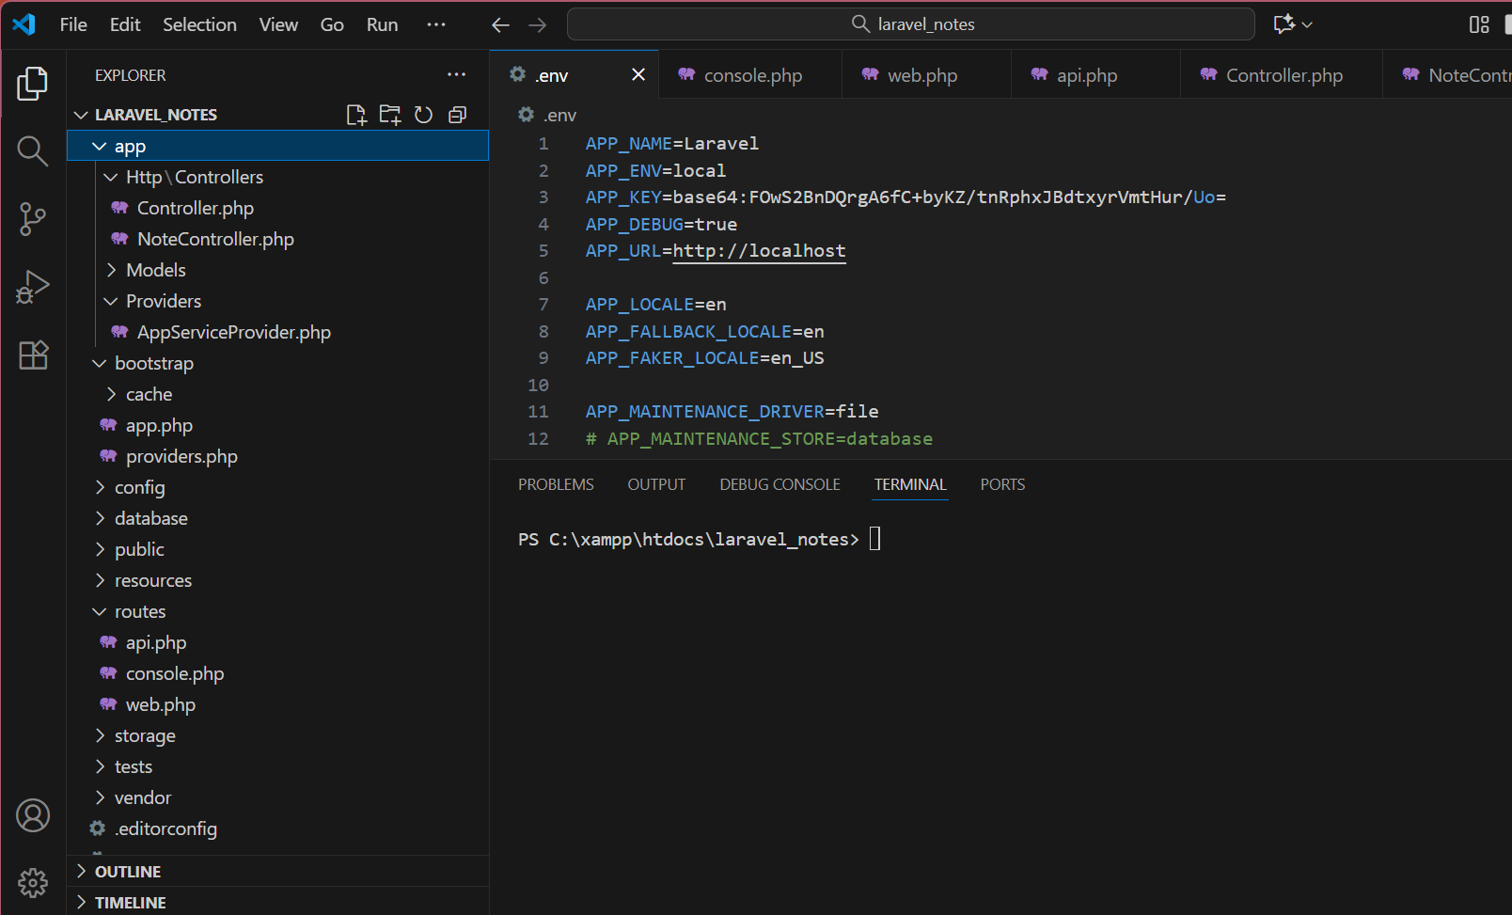

Slide 19
Connect to Your Existing Database
In VS Code, open the file named .env (in your project’s root folder).
Find and edit this section exactly like this:
DB_CONNECTION=mysql
DB_HOST=127.0.0.1
DB_PORT=3306
DB_DATABASE=csci6040_study
DB_USERNAME=root
DB_PASSWORD=

Slide 20
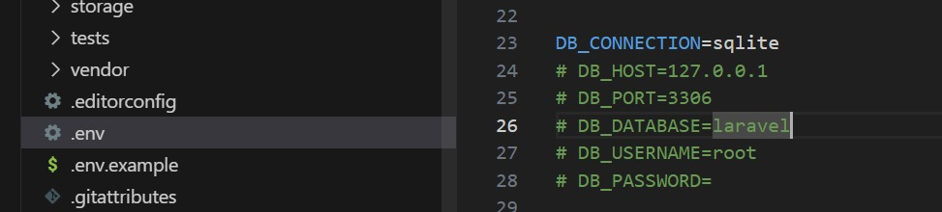
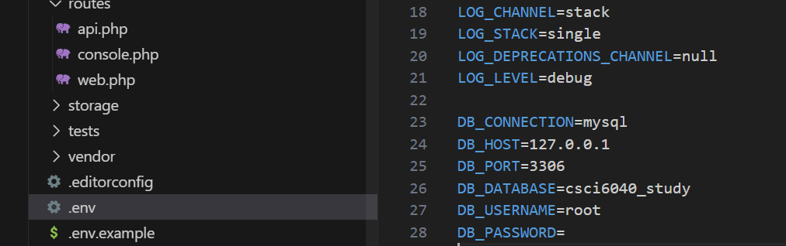
Save the file (Ctrl + S). ✅ This connects Laravel to your existing MySQL database and the notes table you already created.

Slide 21
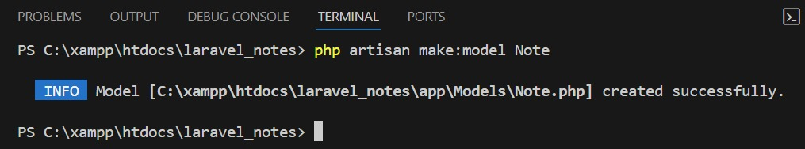
Create a Model
In the VS Code terminal:
php artisan make:model Note
This creates app/Models/Note.php.
Create a Note model that connects to my notes table in the database.

Slide 22
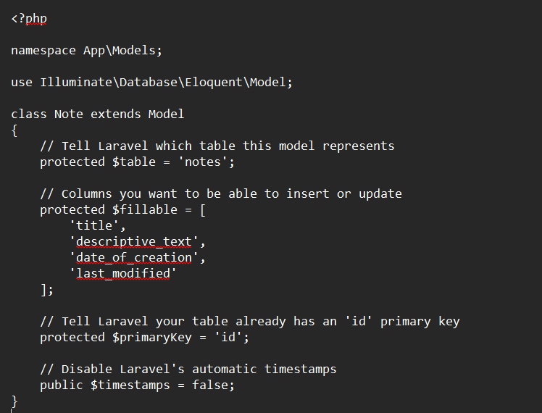
Edit the created model as follows:

Slide 23
This file tells Laravel how to connect with my database table called notes. It acts like a bridge between the code and the database.
protected $table = 'notes’; 👉 This tells Laravel that the table name in the database is notes.
protected $fillable = [...] 👉 These are the columns we can add or update in the table (like title, text, etc.).
protected $primaryKey = 'id'; 👉 This tells Laravel the main column (primary key) of the table is id.
public $timestamps = false; 👉 This tells Laravel not to expect created_at or updated_at columns, because my table uses date_of_creation and last_modified instead.
“This model connects my Laravel project with the notes table in the database and tells Laravel which columns it can work with.”

Slide 24
Create Controller for CRUD
The controller acts like a manager between:
The database (where data is stored), and
The user or API (who sends the request).
Command:
php artisan make:controller NoteController –resource
This command automatically creates all the basic functions we need for CRUD:
Add new note
Show all notes
Show one note
Update note
Delete note

Slide 25
Confirm You Have api.php
Go to your project folder: C:\xampp\htdocs\laravel_notes\routes\
You should see a file named:
api.php
If you don’t see it, create it manually:
Right-click → New File → name it api.php
Paste this code inside:
<?php
use Illuminate\Http\Request;
use Illuminate\Support\Facades\Route;
use App\Http\Controllers\NoteController;
// Route for CRUD operations
Route::apiResource('notes', NoteController::class);
Save the file (Ctrl + S).
This creates all the CRUD routes automatically for your API. So instead of writing 5 different routes (for create, read, update, delete), Laravel gives you all of them in one line.

Slide 26
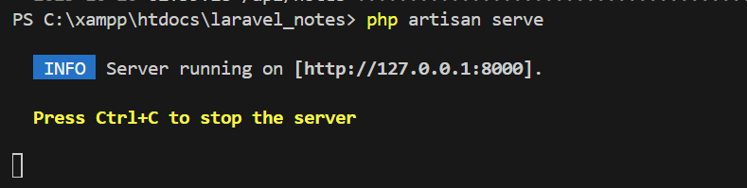
Run Laravel Server
In your project folder, run:
php artisan serve
You’ll see:
Starting Laravel development server: http://127.0.0.1:8000
This command starts Laravel’s built-in web server so you can see and test your project in the browser (like Postman or at http://127.0.0.1:8000).

Slide 27
Test in Postman
Use these endpoints:
Operation | Method | URL | Example Body (JSON)
Create | POST | http://127.0.0.1:8000/api/notes | { "title": "New Note", "descriptive_text": "Hello", "student_id": 1 }
Read All | GET | http://127.0.0.1:8000/api/notes | —
Read One | GET | http://127.0.0.1:8000/api/notes/1 | —
Update | PUT | http://127.0.0.1:8000/api/notes/1 | { "title": "Updated Note" }
Delete | DELETE | http://127.0.0.1:8000/api/notes/1 | —

Slide 28
Upload to GitHub
Step 1: Open your Laravel project folder
Go to your project folder in VS Code terminal or Command Prompt. Example:
cd C:\xampp\htdocs\laravel-notes
Step 2: Initialize Git
This tells Git to start tracking your project.
git init
Step 3: Add all your project files
This adds all files to Git for the first time.
git add .

Slide 29
Step 4: Save your changes (commit)
Write a short message about your upload.
git commit -m "Initial commit“
step 5: Create a repository on GitHub
Go to https://github.com
Click New Repository
Name it: laravel-notes-crud
Keep it Public
Don’t add any README or files yet
Click Create repository

Slide 30
Step 6: Connect your local project to GitHub
Copy the link shown on GitHub — it looks like:
https://github.com/yourusername/laravel-notes-crud.git
Then paste it into your terminal:
git remote add origin https://github.com/yourusername/laravel-notes-crud.git
git remote add origin https://github.com/Jyothishma130/Laravel-notes-crud

Slide 31
Step 7: Set main branch name
git branch -M main
Step 8: Upload your project
git push -u origin main
My LINK:
https://github.com/Jyothishma130/Laravel-notes-crud.git

